Slide 1

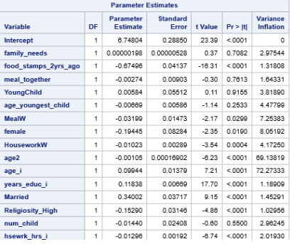
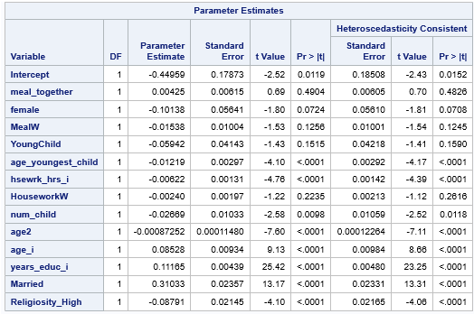

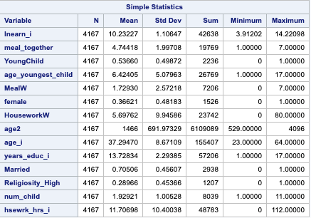
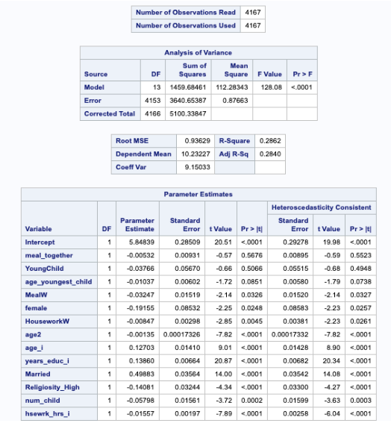

Unpaid Labor: How the habit of Home Cooked Meals could lower Women’s Earnings.
Ethan Norton, Valparaiso University
Data and Key Results
Robustness Check
Justification and Literature Review
Lack of Multicollinearity
The variables without a change in functional form are all below Variance Inflation levels of 5, so there is no multicollinearity in this model.
Variable Construction
MealW was constructed as a Slope Dummy variable. It grouped together Female as well as Hsewrk_hrs_i.
The HouseworkW variable is defined as if a female and the amount of associated earnings decrease based upon overall individual housework hours. Earlier studies have looked at housework hours on the individual level, as well as the split between each gender (Dush 2017; Avery 2010; Bianchi 2012)..
Additionally, some minor transformations happened to other variables. For example, Age_i was squared(forming Age2) to capture the parabola shape of lifelong earnings.
Also, a dummy variable was formatted around age_youngest_child creating youngchild. The reason for this is that there is an unpaid labor difference in the housework associated with a child under 5, apart from a child above 5. When adding Youngchild into the regression, it turned MealW into a statistically significant variable.
Key Significant Variables and Interpretations
Adjusted R-squared. 28.40% percent of the variation in the regression in the natural log of the individual’s labor earnings can be explained by the independent variables, adjusting for degrees of freedom.(Female, Married, hsewrk_i, age2, age_i, num_child, MealW, religiosity_high, years_educ_i, HouseworkW, meal_together, age_youngest_child, youngchild).
Significant Variables at 5% level: MealW, Female, HouseworkW
Omitted Variables: Total hours worked towards labor job.
Significant Variables at 1% level: Hsewrk_hrs_i, num_child, married, years_educ_i, age_i, religiosity_high.
F stat=F(4153)=128.08 and a P-value<.0001. Reject the null hypothesis, as there is sufficient evidence to conclude that there is an overall significant relationship between the independent variables
Originally, this data set and study was going to use wage_i instead of earn_i. Wage_i is defined as the hourly rate from one cent to 998.99 dollars and cents per hour.
However, there was a decision not to due to the female variable not being statistically significant.
The model is attached below, as wage_i changed the signs on both of the two main variables, MealsW and HouseworkW.
Abstract-Using data on households/individuals in America from the 2011 Panel Study of Income Dynamics(PSID), this article focuses on the motherhood penalty and specifically how unpaid work labor for females influences their pay. While previous studies have looked at this variable as well as using Ordinary Least Squares(OLS), there are no major articles that articulate it using slope dummy format. This article articulates the impact unpaid labor hours has on the earnings of a female. The results found demonstrate that the combination of high unpaid labor hours for females as well as the amount of meals eaten together as a family weekly. Also, the study will show that women are more heavily affected by meals prepared than men, through the use of a slope dummy. This study will study the relationship between frequency of unpaid housework hours and women and men’s wages separately.
Keywords: unpaid-labor, wages, gender.
Research Question- Is there a relationship between the frequency of meals eaten together as a family and a difference in women’s and men’s wages separately?
Motivation behind Research Question
This targets a specific variable of unpaid labor hours- the amount of times the family has a meal together during a given week. The range from this is zero times to seven times(every day).
No other major article has focused on this variable in depth.
Related Studies
There is a plethora of evidence that suggests an increase in unpaid labor leads to decrease earnings for women (Schneider 2011; Craig and Sawrikar 2009; Becker 2010; Raley, Bianchi, Wang 2010; Staff and Jeylan 2011).
One study found that even when men and women make the same amount of money(or the women make more), the women still performs more house duties(Killewald 2011).
Mothers may suffer a growing disadvantage over time if their lack of early investment in human capital and discontinuity in work experience keeps them out of high paying occupations and deny them opportunities for significant wage growth and occupational mobility later in life(Kahn 2014).
Heteroscedasticity
The value is below that .05 threshold which indicates there is heteroscedasticity in the model. P-values in the final regression have been altered to reflect this.
Descriptive Statistics
The results above seem reasonable, however 112 hours of unpaid labor weekly seems excessive. It is also surprising that the highest man has a higher amount of housework hours than the highest woman. The number of children at 11 also seems pretty high.
Final Regression
Conclusions
Focused on OLS(Ordinary Least Squares), if an individual is a woman and as the amount of meals eaten together weekly as a family increases, is associated with lower earnings.
Also, If the individual is a female and as the amount of housework hours increases by one hour weekly(decreasing her work assigned to job), her expected percentage of total labor earnings is expected to decrease.
This appears to be the first time this approach has been done to meals together, and the approach has yielded statistically significant results.
The other variables used in the regression remain consistent with modern literature, so this shows that the slope dummy, MealW, is still statistically significant in the context of modern research.
Policies and Future Research
Universal Child Care
Paid maternity Leave
Universal Base Income for Mothers
Further study should be conducted to account for total hours worked toward labor job. Changing the dependant variable to wage_i was not sufficient.

